Slide 1
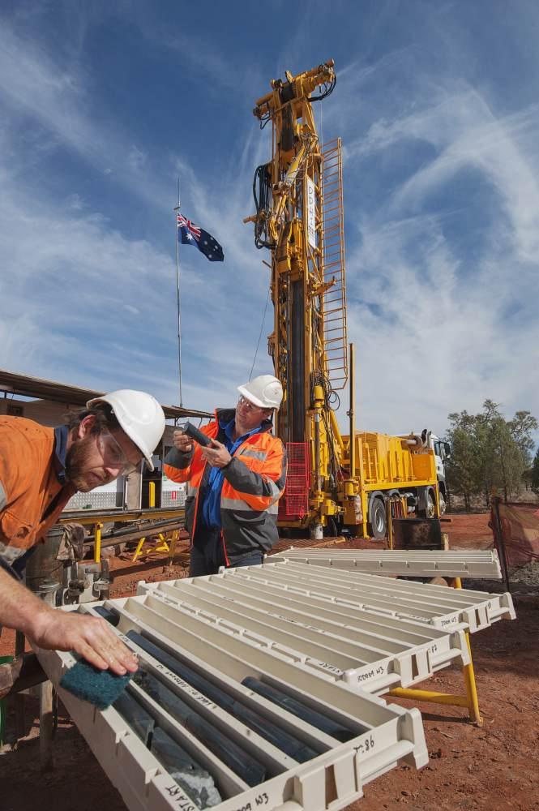
The Mallee Bull Discovery and Exploration in the Central Cobar Basin
Michael Oates ,Bob Brown & Nathan Chapman
Mines and Wines 2013
(Image: DDH1 drilling at Mallee Bull)
Peel Mining Limited (ASX:PEX)
Mines and Wines – Sept 2013
www.peelmining.com.au

Slide 2
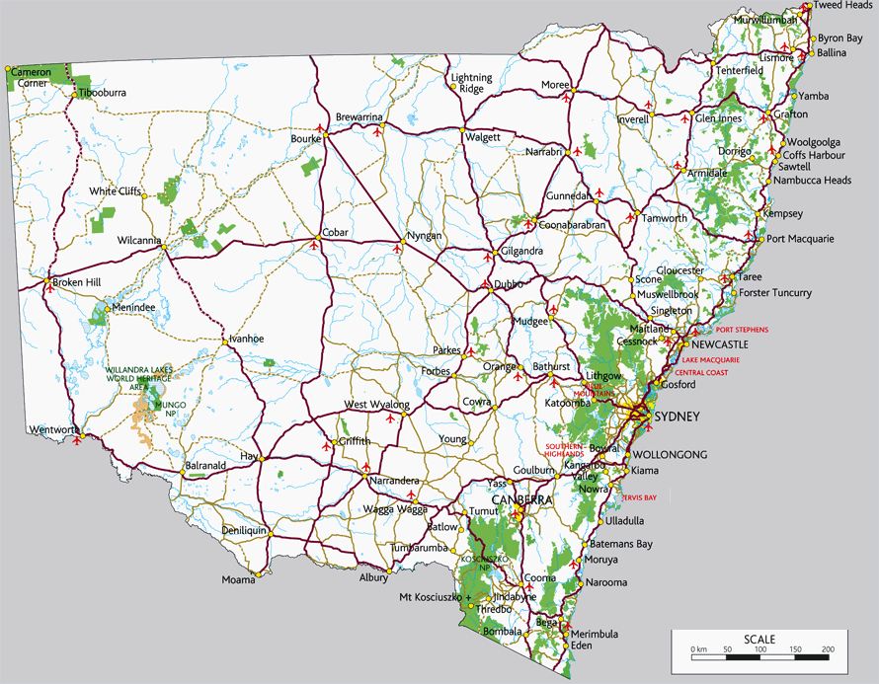
Mallee Bull Location
Mallee Bull
Notes:
Located in central NSW 110km south of the town of Cobar, 10km east of the Gilgunnia rest stop of the Kidman highway

Slide 3
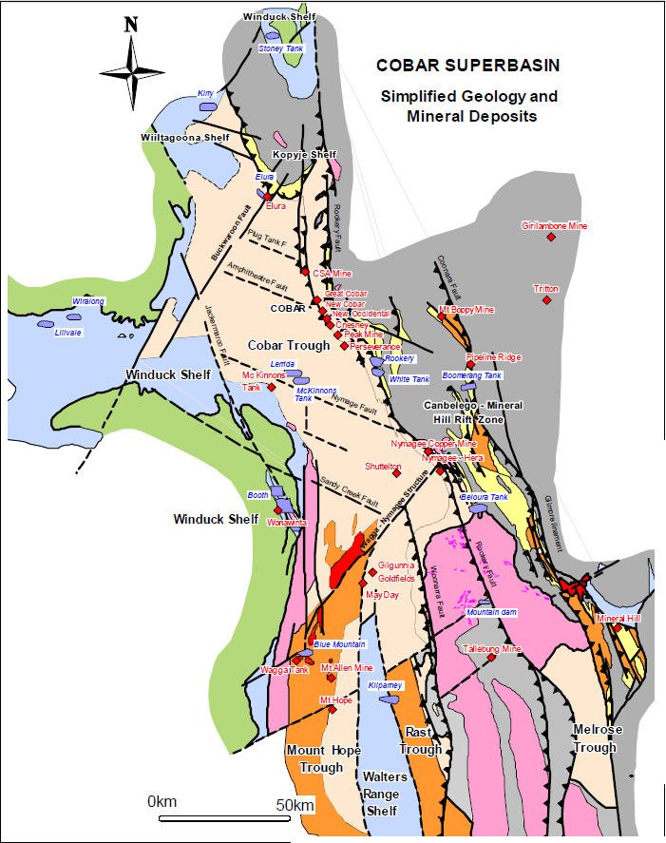
Cobar Superbasin (David 2005)
Notes:
Mallee Bull is located adjacent the historic four mile goldfield in the central region of the Cobar Super Basin, north of the Walters Range Shelf where the volcanic dominated Rast and Mount Hope troughs appear to coalesce and mix with turbiditic sediments of the Cobar Superbasin. Its proximity to the Wagga to Nymagee lineament

Slide 4
EL7461 pegged Sept 2009
Notes:
Peel mining pegged EL7461 in September 2009 on the basis of the two historic goldfields, geology prospective for “Cobar Style” mineralisation, untested geophysical target and its proximity to the Mayday mine.

Slide 5
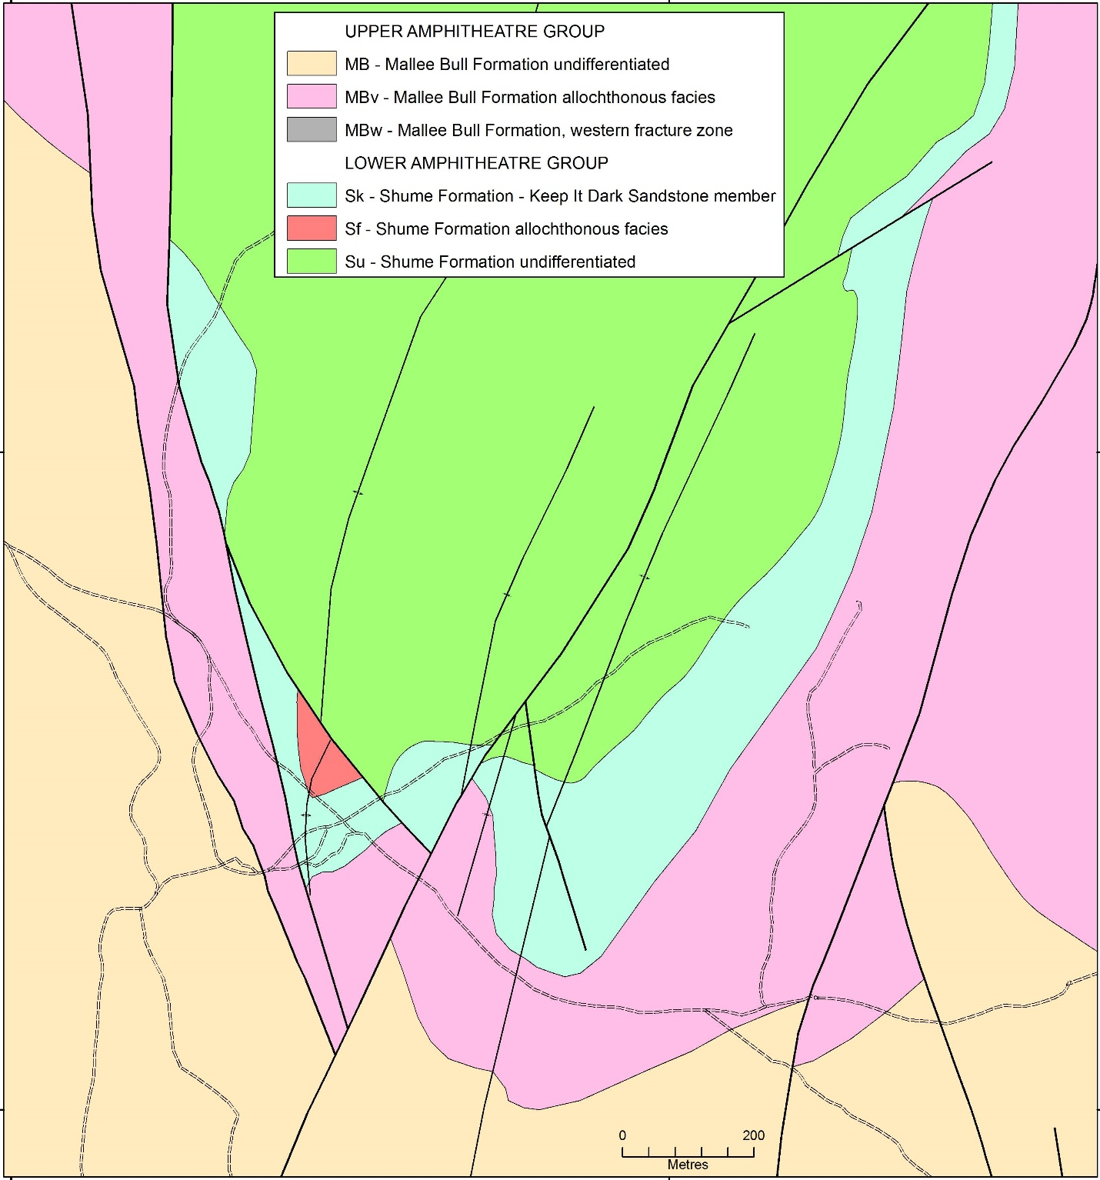
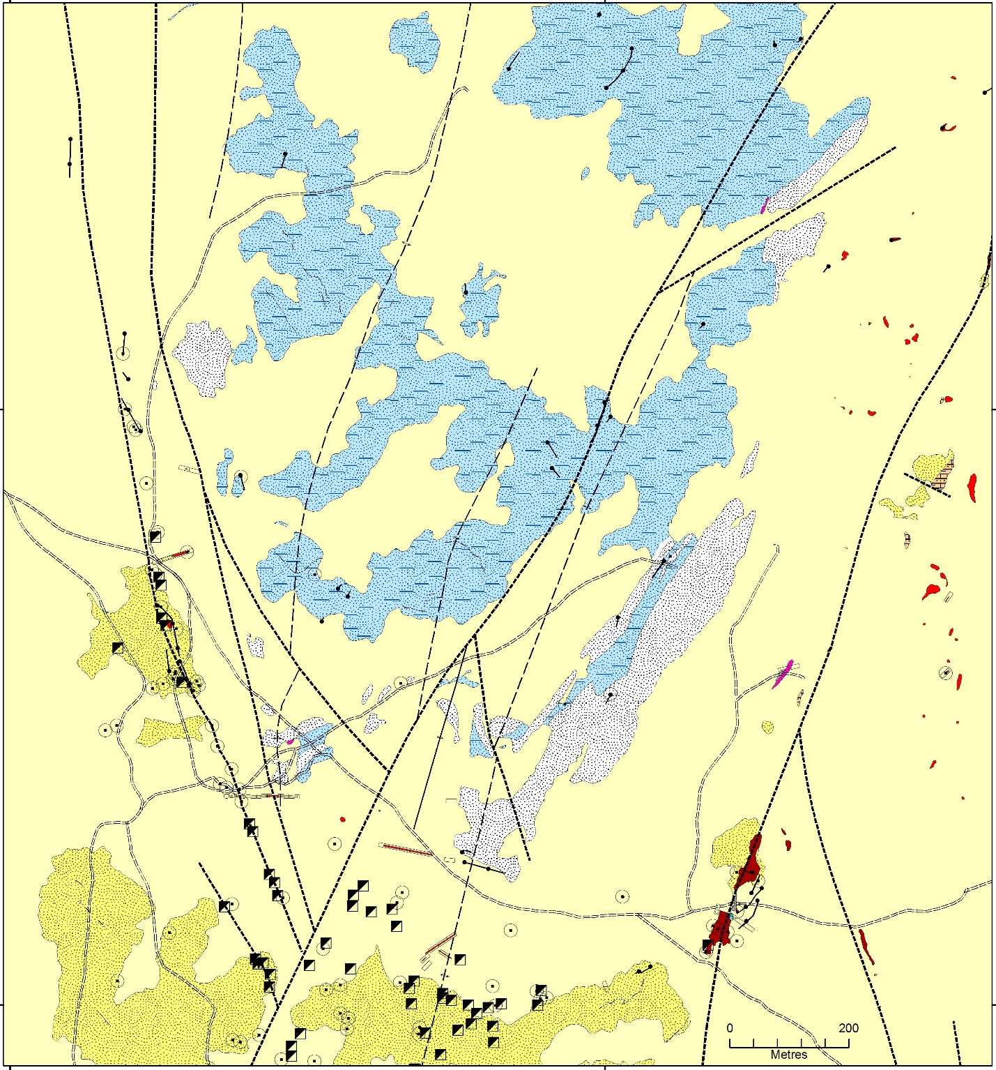
Local Setting
No obvious surface expression
Western limb of south plunging anticlinorium
Ore body dips steeply to the west
Mineralisation parallel to sub parallel to bedding
120m wide , up to 20m thick, 700m deep so far
Dominant steep axial plane cleavage
Upright symmetrical folding
West dipping NNW hanging wall fault
NNE Fault associated with fluid movement
Deposition within dilation zones and porous units
Mallee Bull

Slide 6
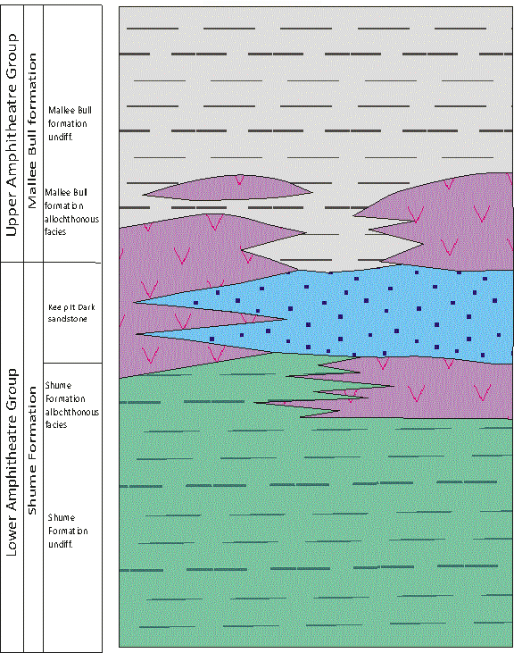
Stratigraphy
Hosted by rocks of the Upper and Lower Amphitheatre gp
Upper Amphitheatre Group - Mallee Bull Formation
Lower Amphitheatre Group – Shume Formation
Allocthonous Strata separate the two
Mallee Bull Formation Allocthonous Facies
Shume Formation Allocthonous Facies
Quartz Arenite marks the top of the Shume Formation
Keep it Dark Sandstone Member

Slide 7
Shume Formation
Turbiditic sequence
Well Bedded, graded
Fine to medium grained sandstones to mudstones
Abundant dewatering structures
Generally less than 0.5m thick up to 2m
Single well developed cleavage
Similar detrital composition to Mallee bull formation

Slide 8
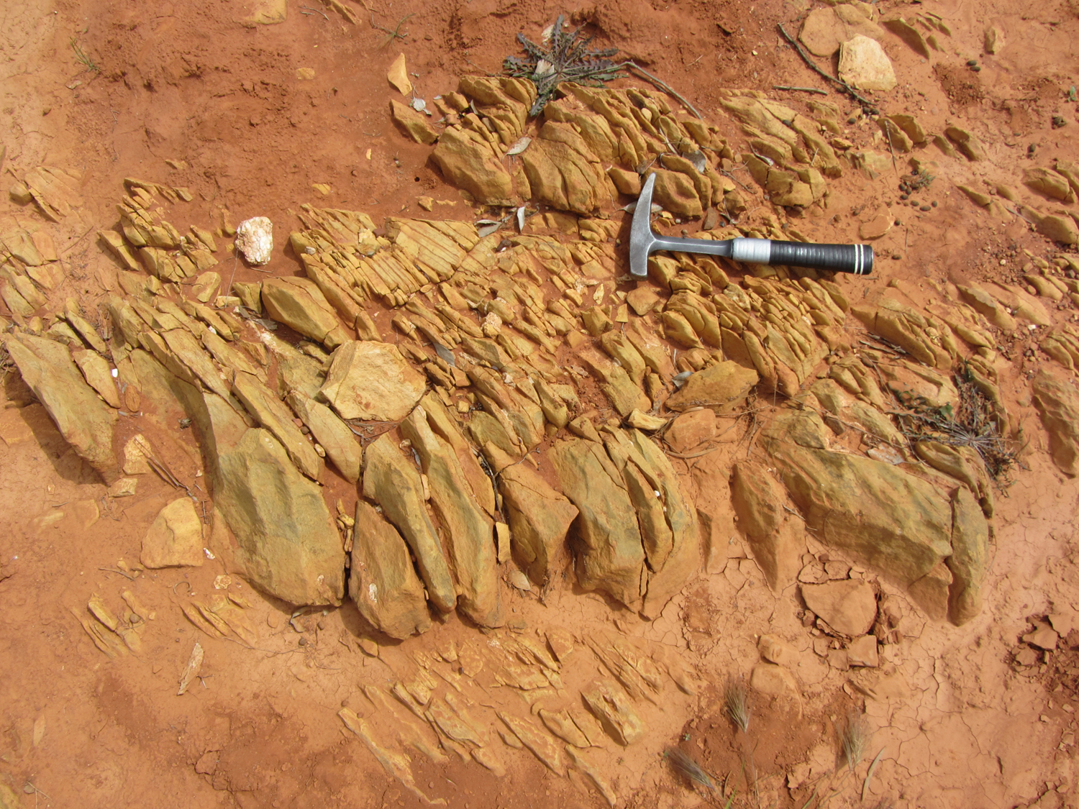
Shume Formation in outcrop
Notes:
Shume in outcrop

Slide 9
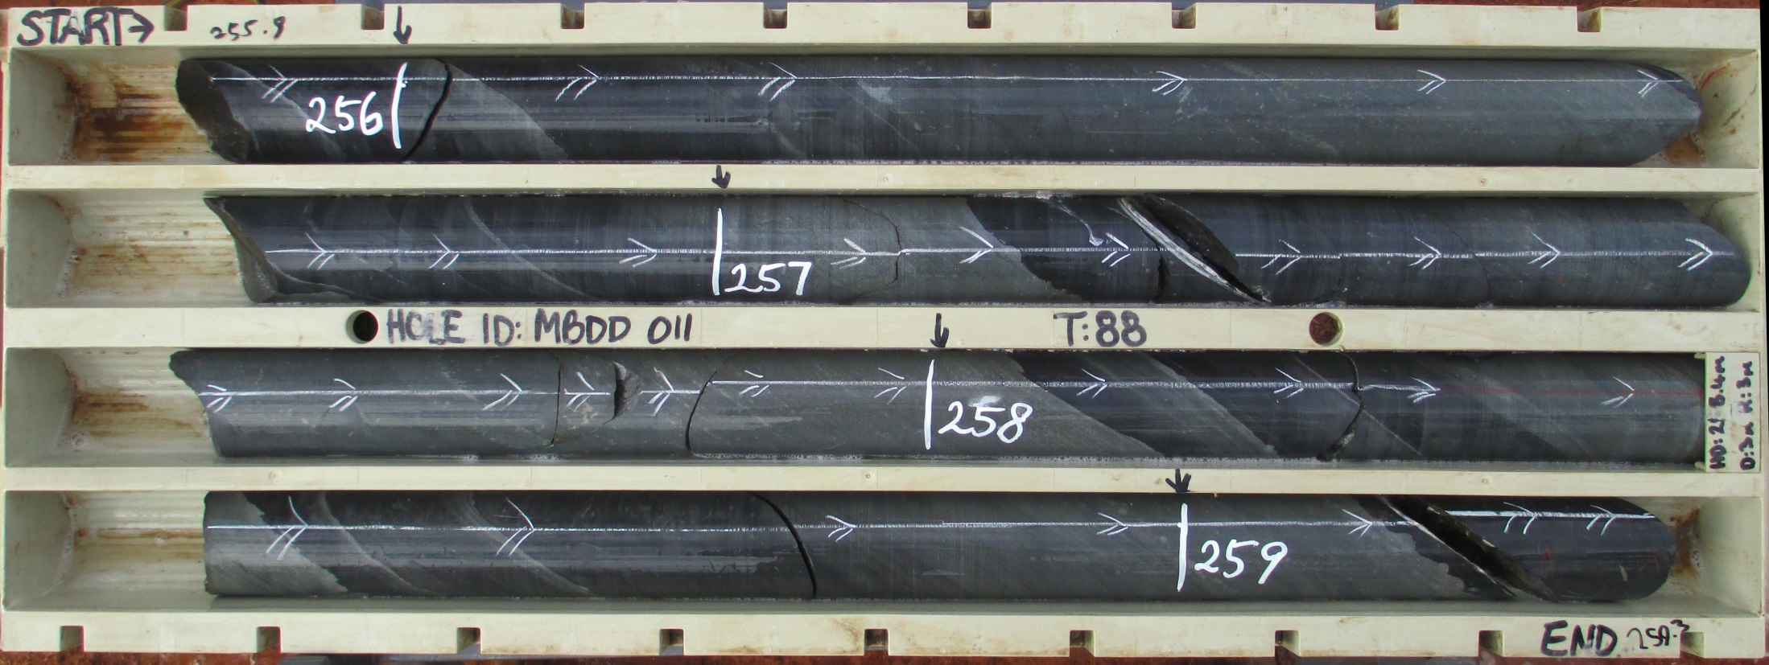
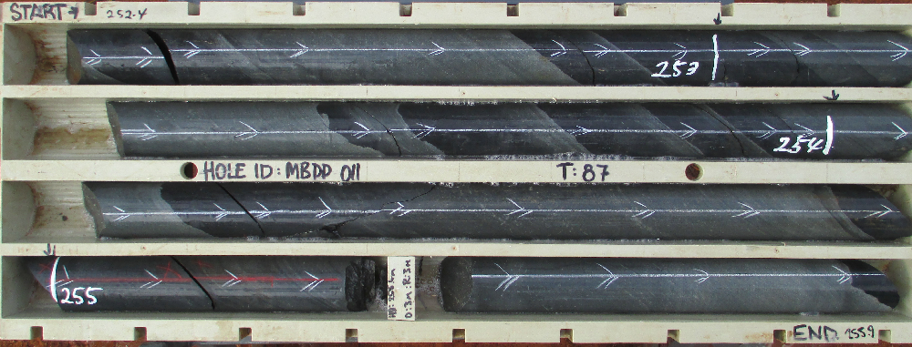
Shume Formation in core
Graded beds < 2m
Notes:
Shume turbidites in core showing graded beds of fine to medium grained sandstones and mudstones, beds up to 2m thick and commonly less than 0.5m.

Slide 10
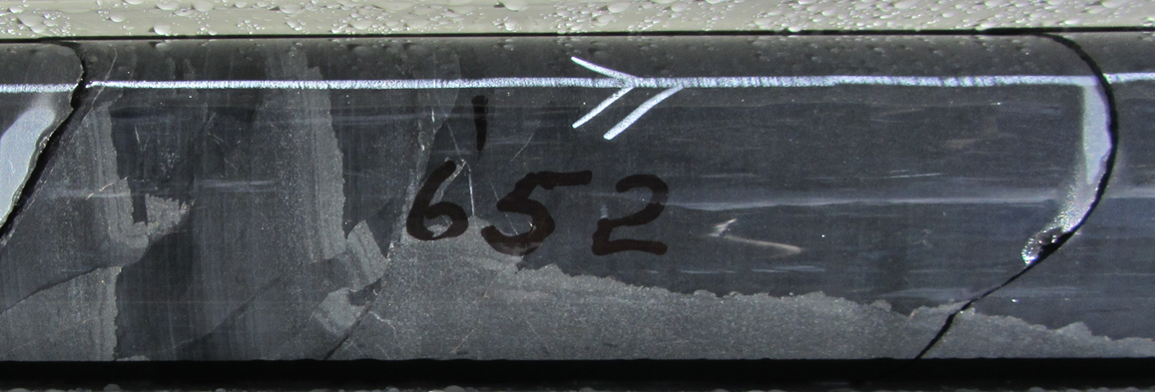
Dewatering Structures
Sedimentary Dyke
Disrupted and Rotated beds
Notes:
Dewatering structures are common throughout

Slide 11
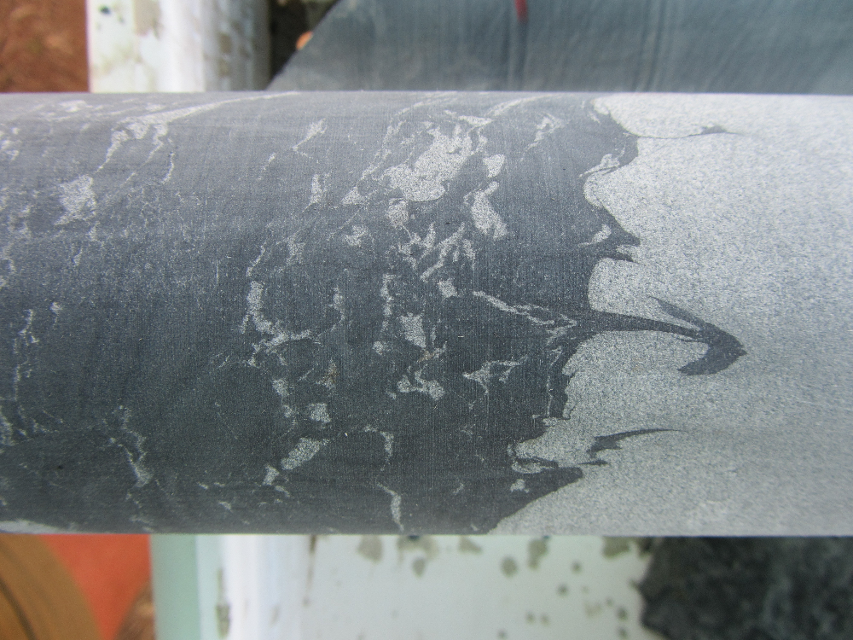
Dewatering Structures

Slide 12
Allocthonous Facies
Felsic Volcaniclastic sandstone beds
Pebbly Sandstone
Diamictite with subordinate bioclastic
(Coarse crinoids, rugose and tabulate corals)
Micritic Limestone

Slide 13
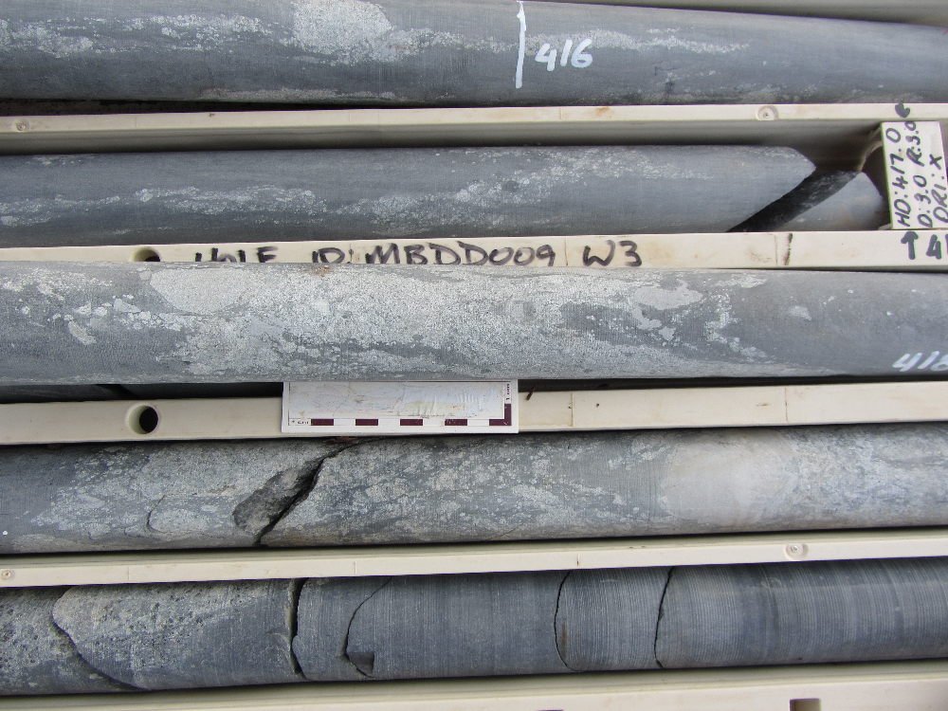
Allocthonous Facies

Slide 14
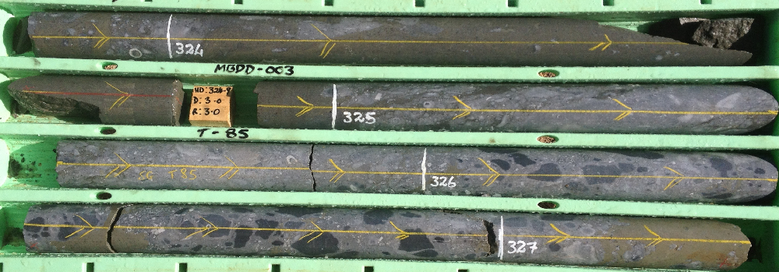
Allocthonous Facies

Slide 15
Keep it Dark Sandstone
Fine grained, well sorted and massive
Quartz Arenite
Deposition from different province
Cm to 10m thick
Massive quartz-calcite veins
Rare laminated beds
Mass flow margins?

Slide 16
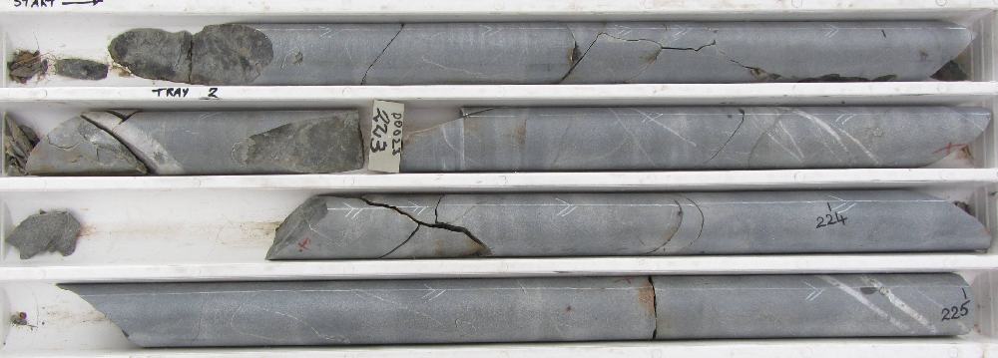
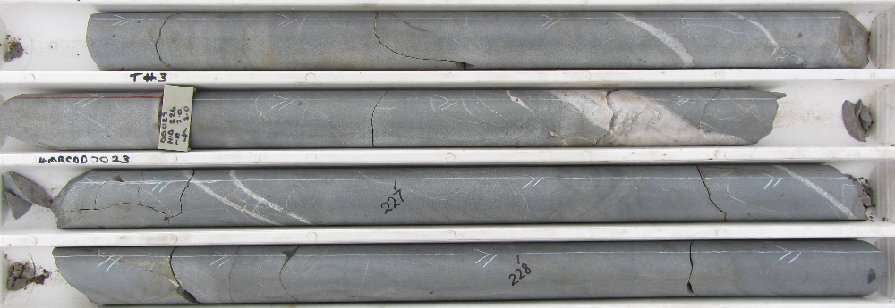
Keep it Dark Sandstone
Cm to up to 10m thick
Quartz /Calcite Veins
Notes:
Keep it Dark sandstone, well sorted, super mature, massive quartz arenite with common white quartz –calcite veins. Ranges in thickness from cm’s to more than 10m and is locally absent. Interpreted as a mass flow deposit sourced from a different providence to that otherwise supplying sediment to the basin.

Slide 17
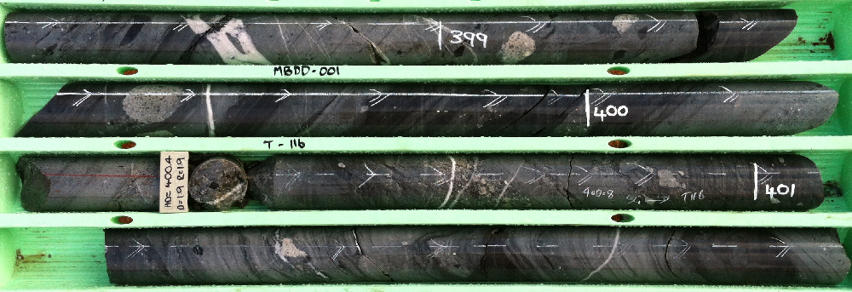
Margins of mass flow lobes
Notes:
In places it forms thinly laminated and rarely cross laminated bed, probably representing the extreme margins of the mass flow lobe.

Slide 18
Mallee Bull Formation
Turbiditic sequence
Graded, fine to medium grained sandstones to mudstones
Dewatering structures
Generally less than 0.5m thick
Similar detrital composition to Shume

Slide 19
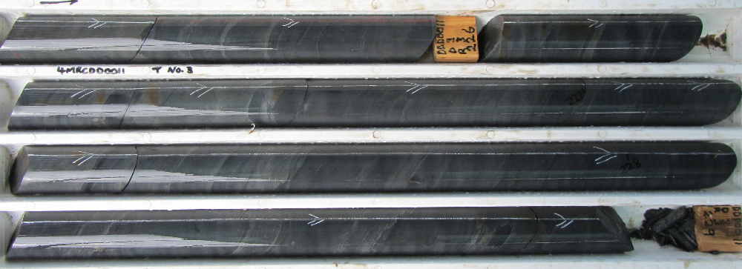
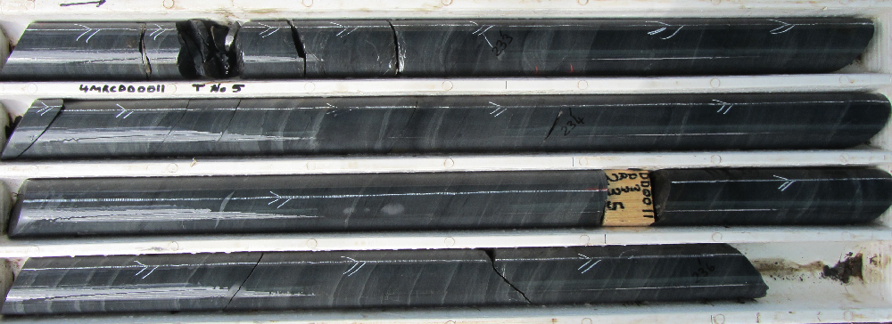
Mallee Bull Formation

Slide 20
Mineralisation
Mineralisation is essentially stratabound and hosted by turbiditic sedimentary rocks with significant allocthonous felsic volcanics and limestone
Mineralisation occurs as massive sulphide lenses, broad disseminations and a copper-rich stringer zone
Mineralisation surrounded by pyrrhotite halo giving magnetic signature
Significant mineralisation occurs stratigraphically below Keep it Dark Sandstone

Slide 21
MINERALISATION AND STRATIGRAPHY

Slide 22
3D Flythrough

Slide 23
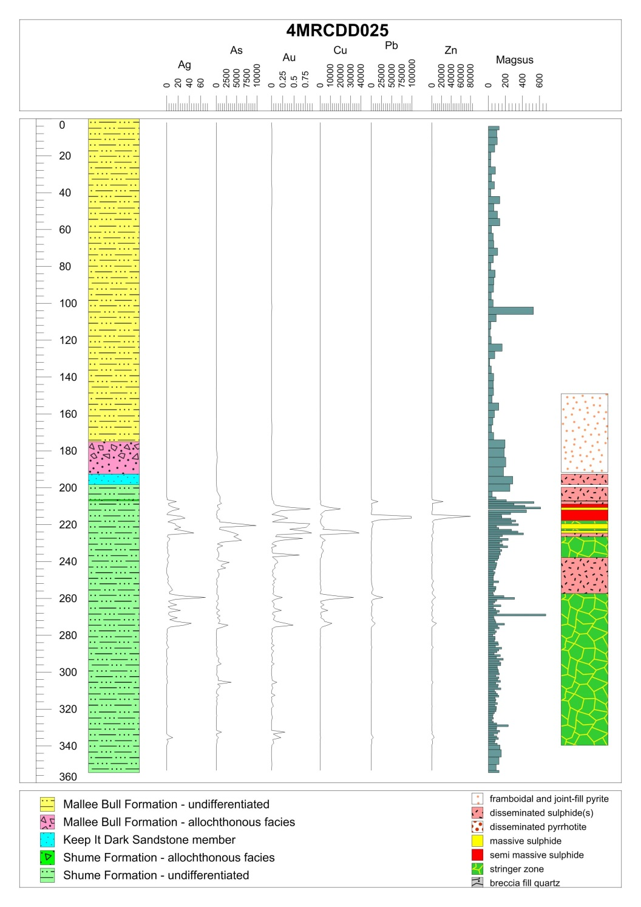
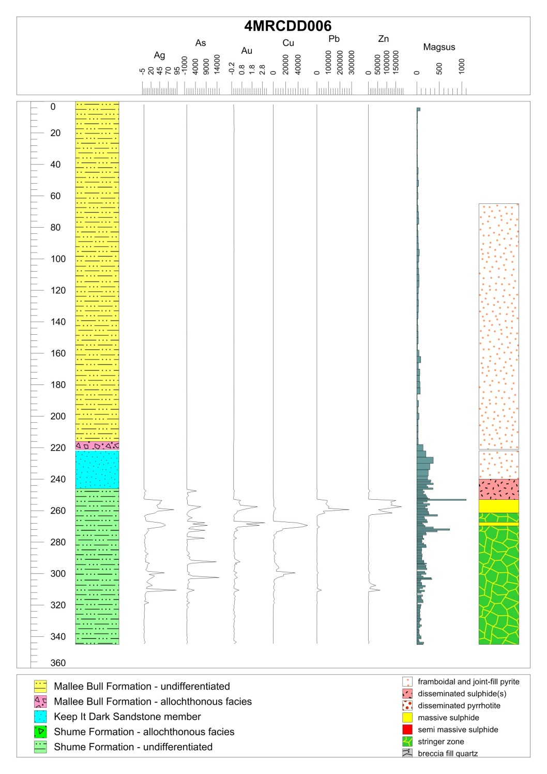
MINERALISATION AND STRATIGRAPHY

Slide 24
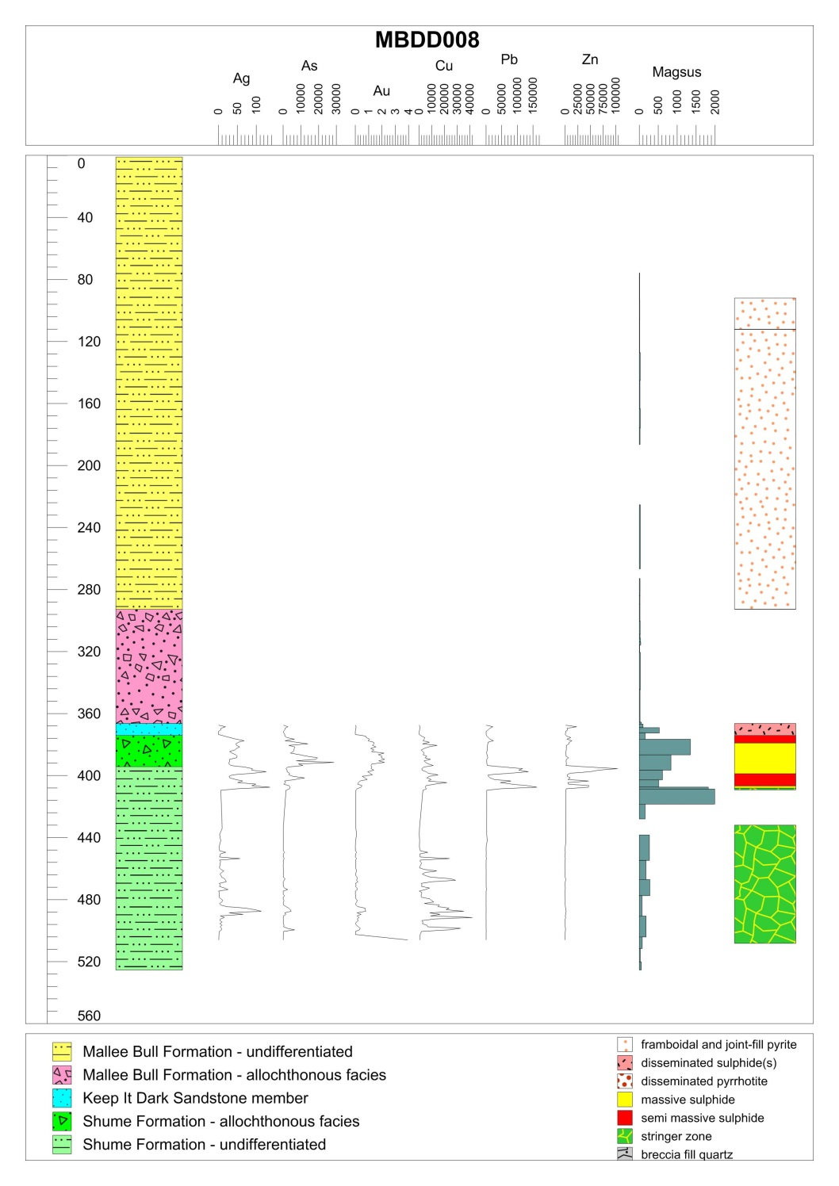
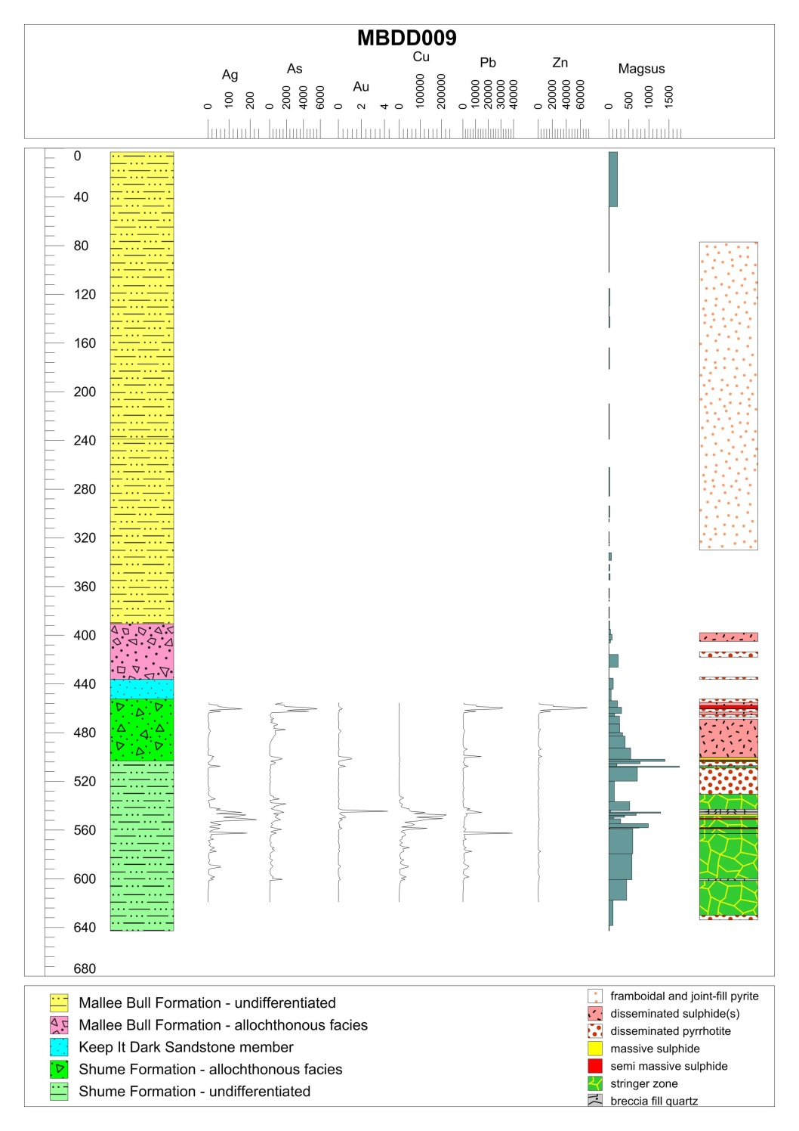
MINERALISATION AND STRATIGRAPHY

Slide 25
Mineralisation Types
1) Disseminated and Joint Fill Pyrite
2) Disseminated Pyrrhotite
3) Massive to Semi Massive Sulphide Lenses
4) Disseminated Mixed Sulphides
5) Cupriferous Stringer Zone

Slide 26
1) Disseminated and Joint –Fill Pyrite
Notes:
Framboidal pyrite showing preference for sandstone laminations

Slide 27
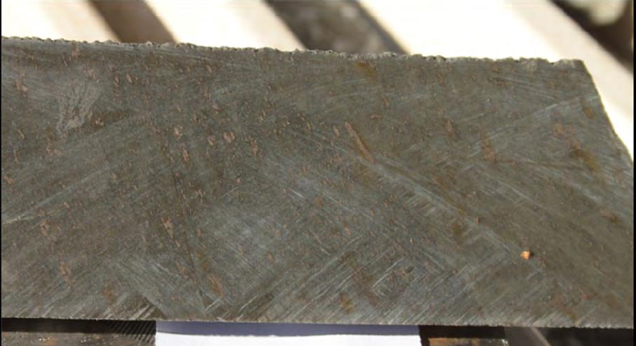
2) Disseminated Pyrrhotite

Slide 28
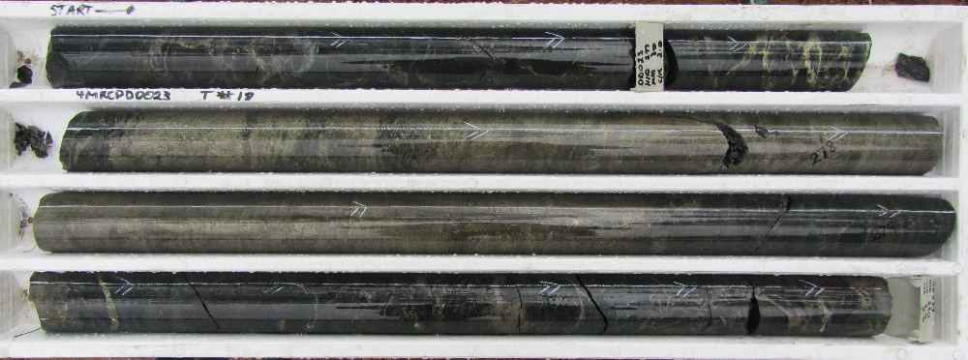
3) Massive to Semi Massive Sulphides
- massive and replacement textured Pyrite and Pyrrhotite
- Single or multiple stacked lenses up to 10m
- minor to trace chalcopyrite, arsenopyrite, sphalerite, galena, rare cassiterite
- anomalous Cu-Pb-Zn-Au-Ag-As
- sharp to gradational boundaries
- locally grade into stringer or disseminated styles
Notes:
Point 3 in abstract

Slide 29
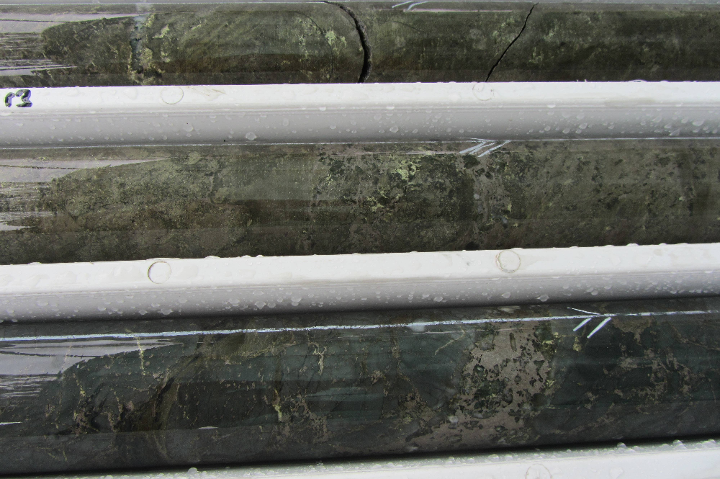
Massive to Semi Massive Sulphides

Slide 30
Massive to Semi Massive Sulphides

Slide 31
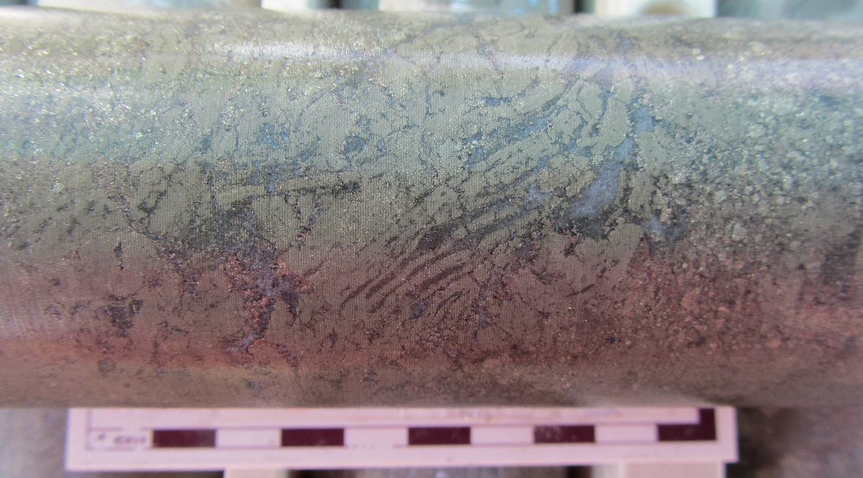
Massive to Semi Massive Sulphides

Slide 32
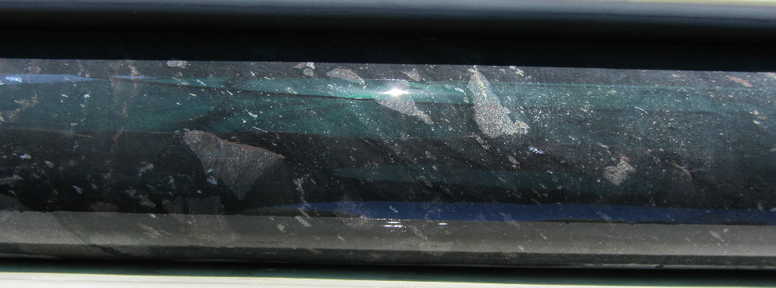
4) Disseminated Mixed Sulphides
- bedding and clast replacement aggregates of pyrrhotite, sphalerite, galena, minor pyrite, chalcopyrite
- anomalous Pb-Zn-Cu-Ag-As
- locally mass together to form stringer veins or semi-massive aggregates
-laterally equivelant to and associated with massive sulphide lenses
Notes:
Point 4 in abstract

Slide 33
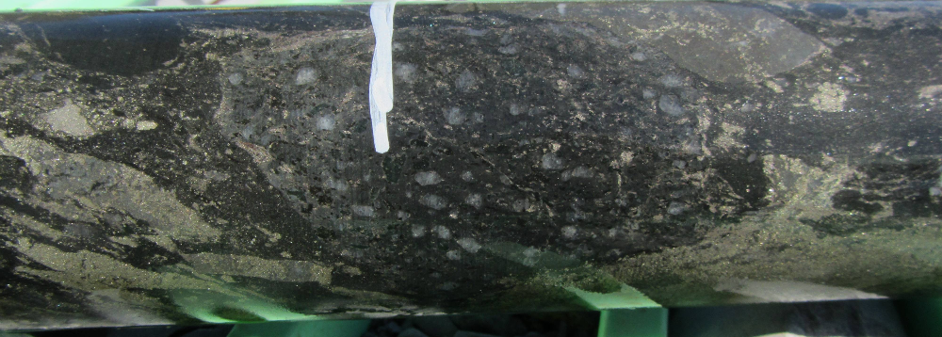
Disseminated Mixed Sulphides

Slide 34
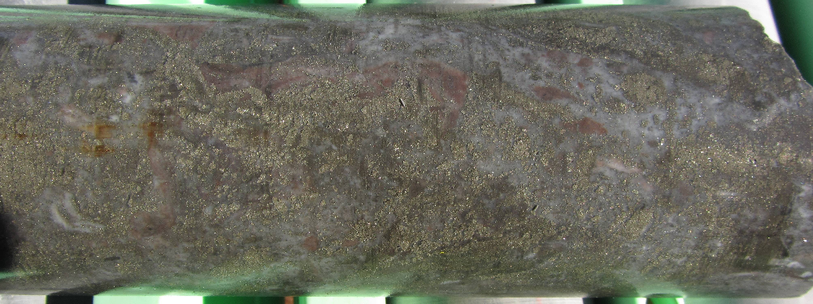
Disseminated Mixed Sulphides
Local semi massive aggregates of coarse inetermixed sphalerite and galena

Slide 35
Disseminated Mixed Sulphides

Slide 36
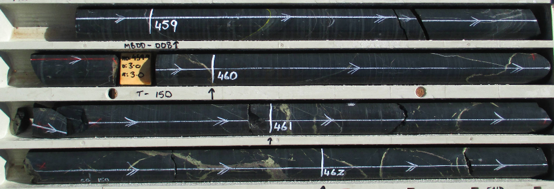
5) Cupriferous Stringer Zone
- pyrrhotite, chalcopyrite, trace to minor arsenopyrite, galena, sphalerite, cassiterite, boulangerite, gold
- anomalous Cu, Ag, Au (in breccia zones), minor Pb
- stringer veins locally aggregate to form semi-massive and massive bodies
- local quartz-sulphide breccias associated with anomalous Au
- local disseminated chalcopyrite
Notes:
Point 5 in the abstract

Slide 37
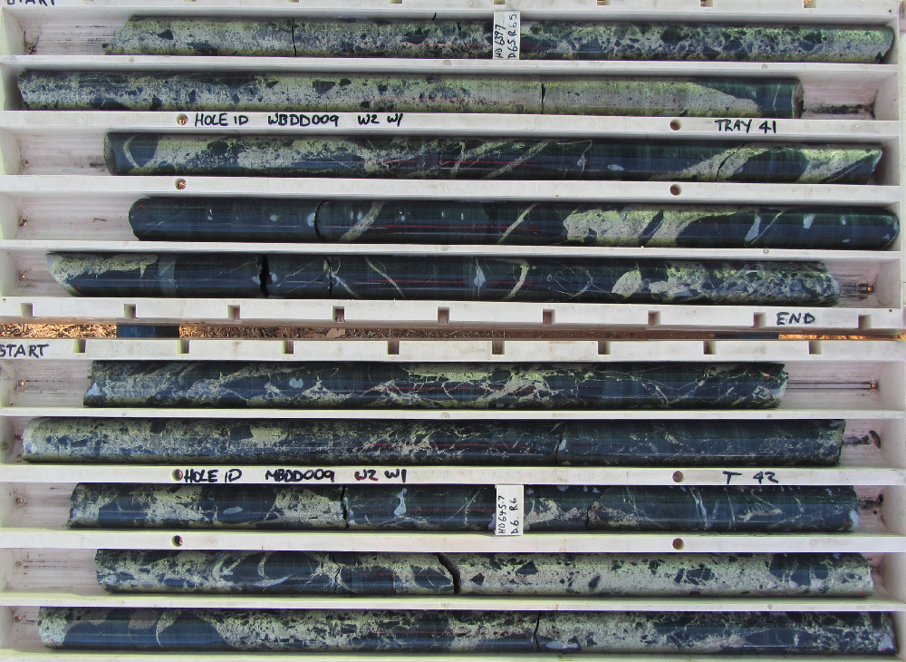
Cupriferous Stringer Zone

Slide 38
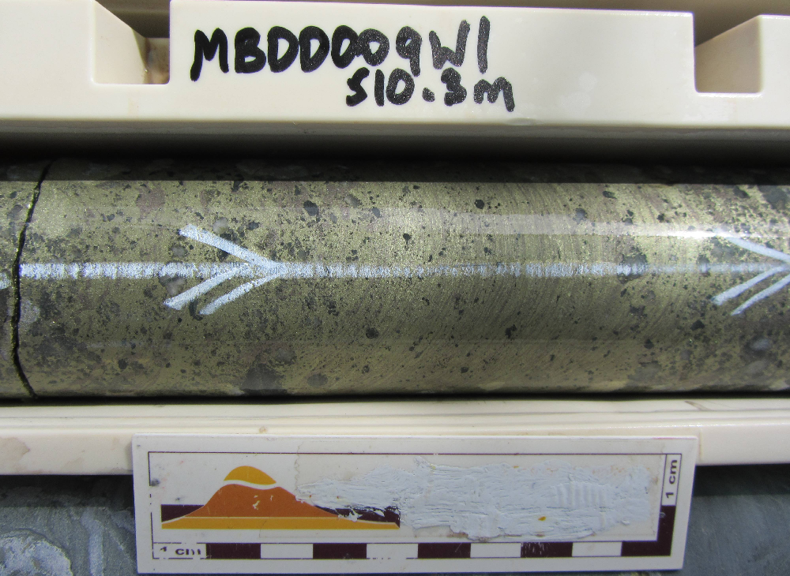
Cupriferous Stringer Zone
Flow laminae from deformation and remobilisation

Slide 39
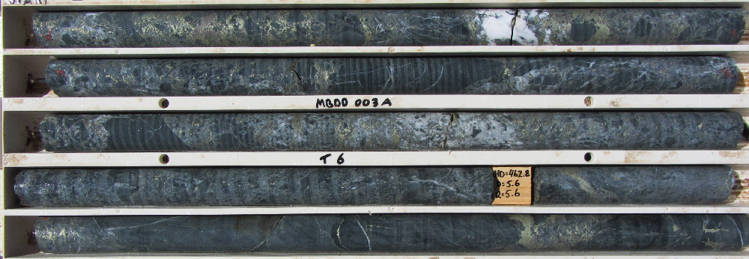
Cupriferous Stringer Zone

Slide 40
Cupriferous Stringer Zone
Quartz healed jigsaw breccia

Slide 41
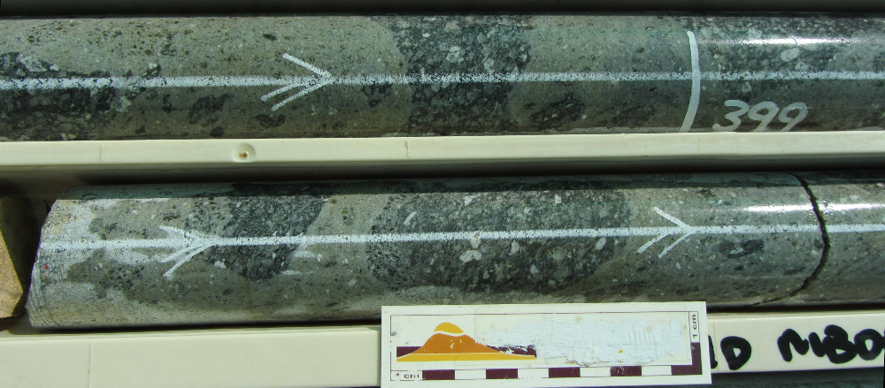
Alteration
sericite alteration of feldspars and ferromagnesium minerals altered to black (Mg)chlorite

Slide 42
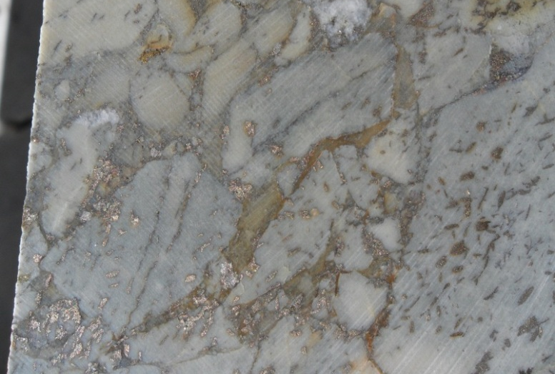
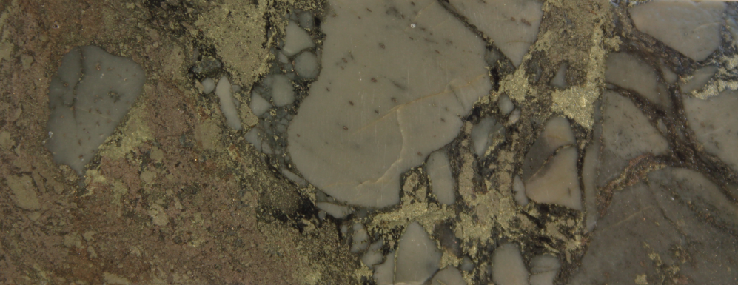
Silicification and black chlorite

Slide 43
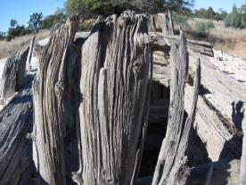
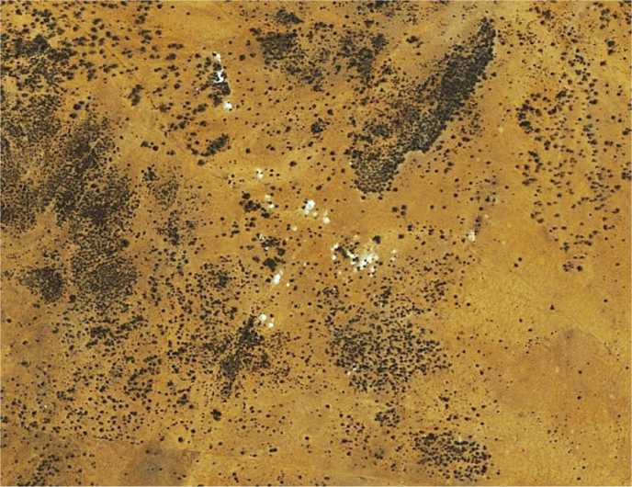
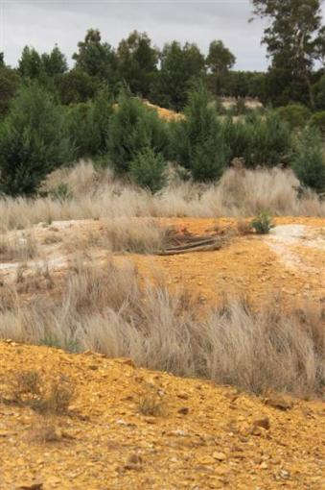
Exploration History
Discovered in 1895 producing 660g

Slide 44
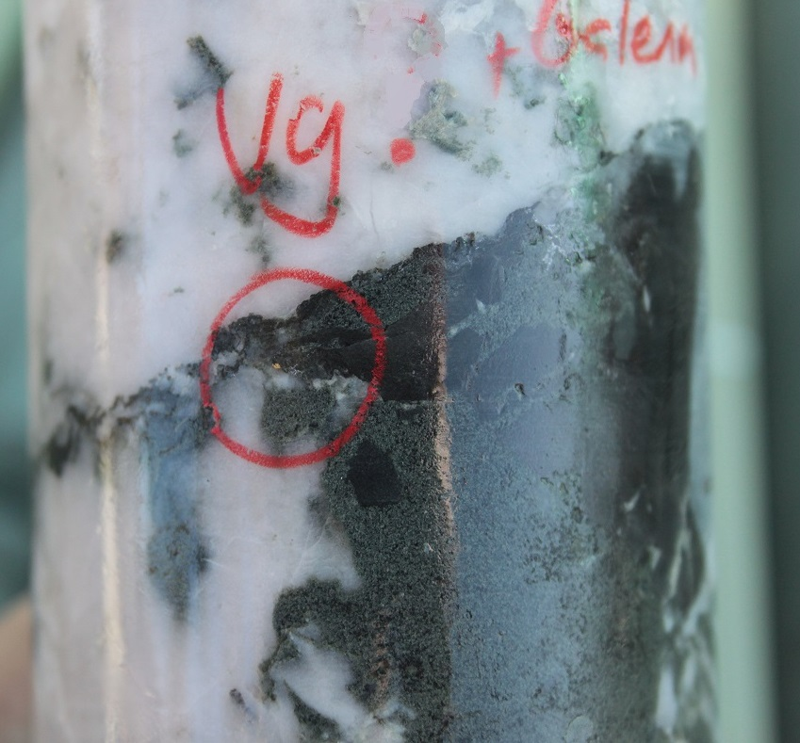
Testing the bulk mining potential of the gold workings
RAB and Auger drilling, mapping, rock chip sampling, trenching
Gold restricted to two Quartz types throughout gold fields
Bucky quartz – Au, poor in base metals, pale green chlorite
Laminated quartz, commonly folded – Au + Cu/Pb/As/Zn signature
cm to meter thick
Strike 020, 120 or 150 and thought to be exploiting foliation
1970 Milstern Exploration/Mount Hope Minerals
1974 Penzoil of Australia
1988 Epoch Mining
1996 Renison Ltd

Slide 45
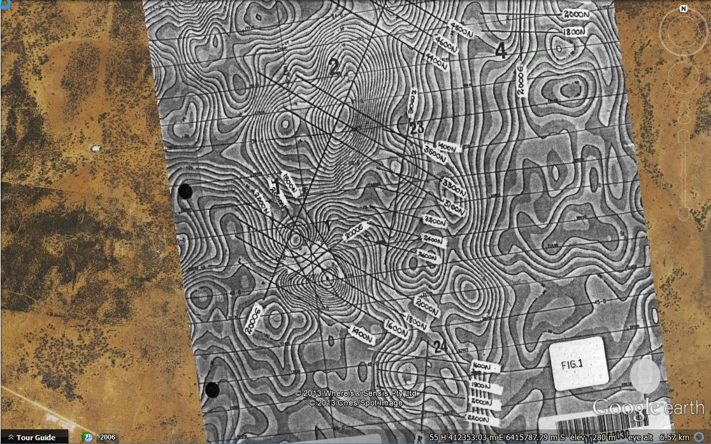
1976 Union Corporation
Union corportion

Slide 46
1976 Union Corporation

Slide 47
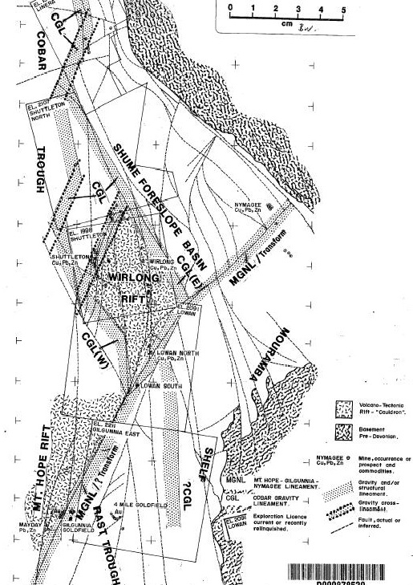
Newmont 1984
David, 2005

Slide 48
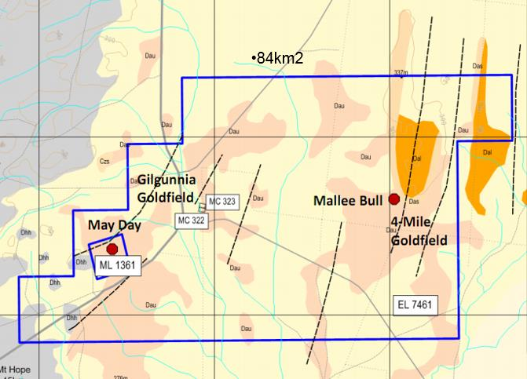
EL7461 pegged as open ground Sept 2009
Local rocks age equivalent to Cobar host
Untested magnetic anomalies
8 kmE of May Day Au-Ag-Pb-Zn-Cu deposit
Deep water and shallow water sediments
Adjacent historic workings
Favourable trap site – nose of anticline
High strain zone

Slide 49
Peel Mining VTEM survey December 2010
Notes:
Coincident magnetic anomaly and discrete late time EM conductor

Slide 50
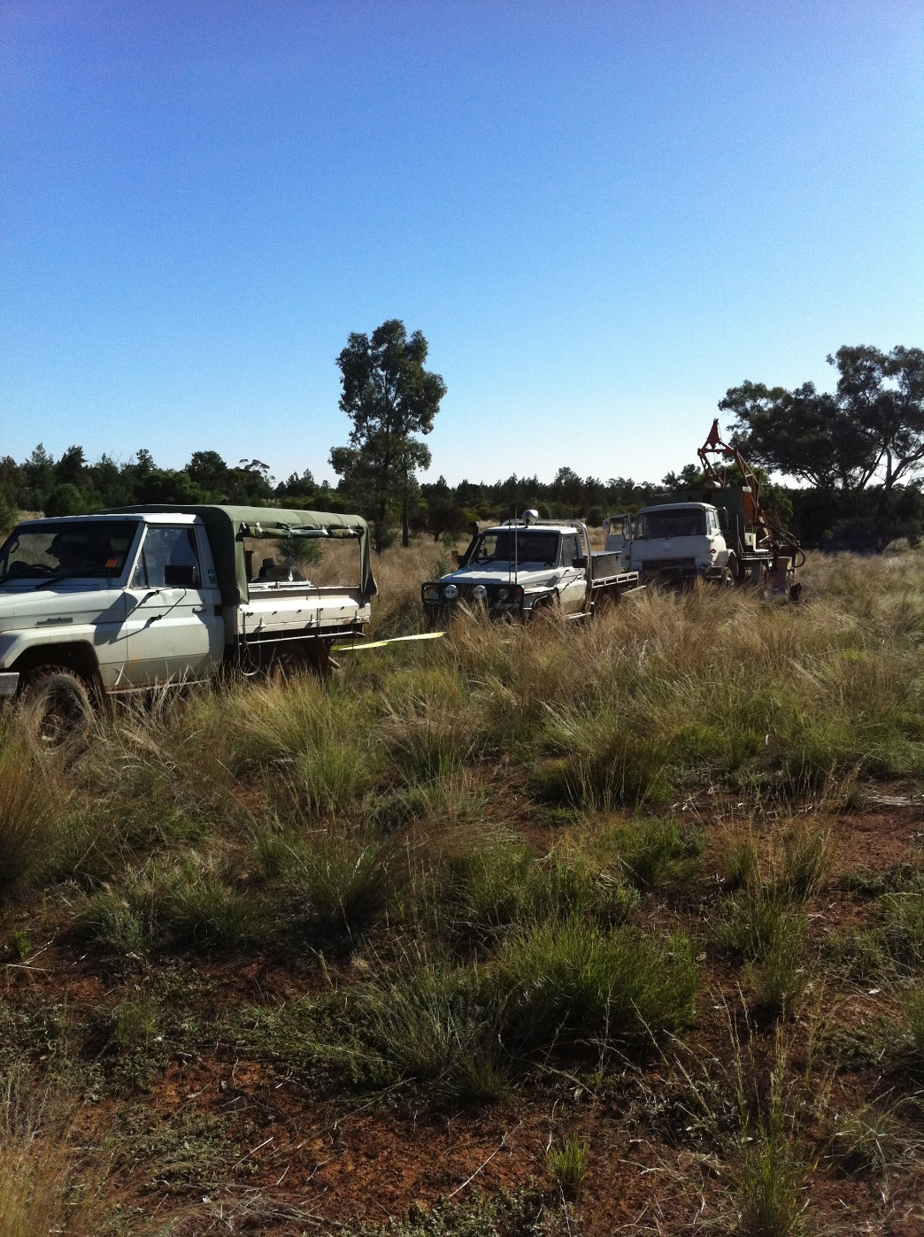
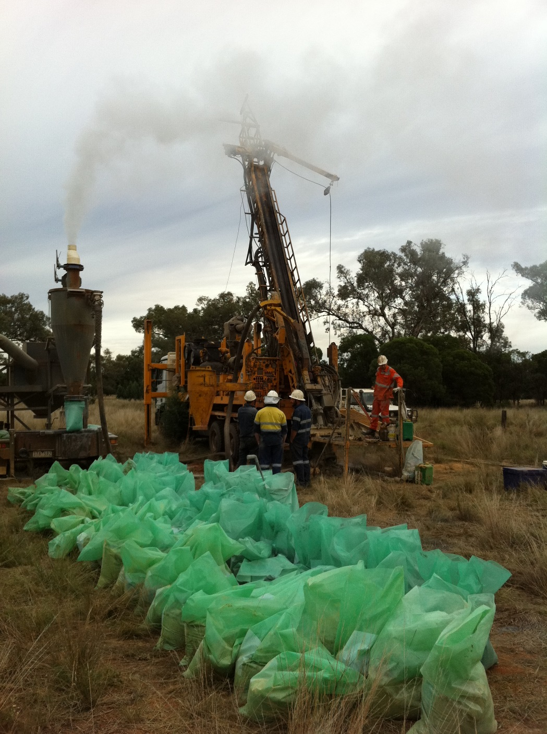
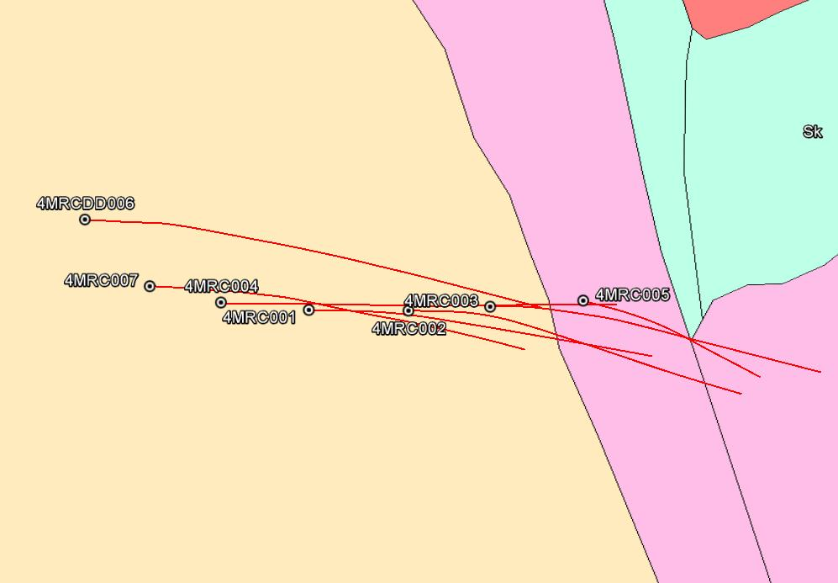
3 Rounds of Drilling before Success
First round of drilling was RAB down to 60m over anomalies
Second round of RC drilling encouraging
DHEM, FLEM and Gyroscopic surveys of drill holes
Third round of drilling success

Slide 51
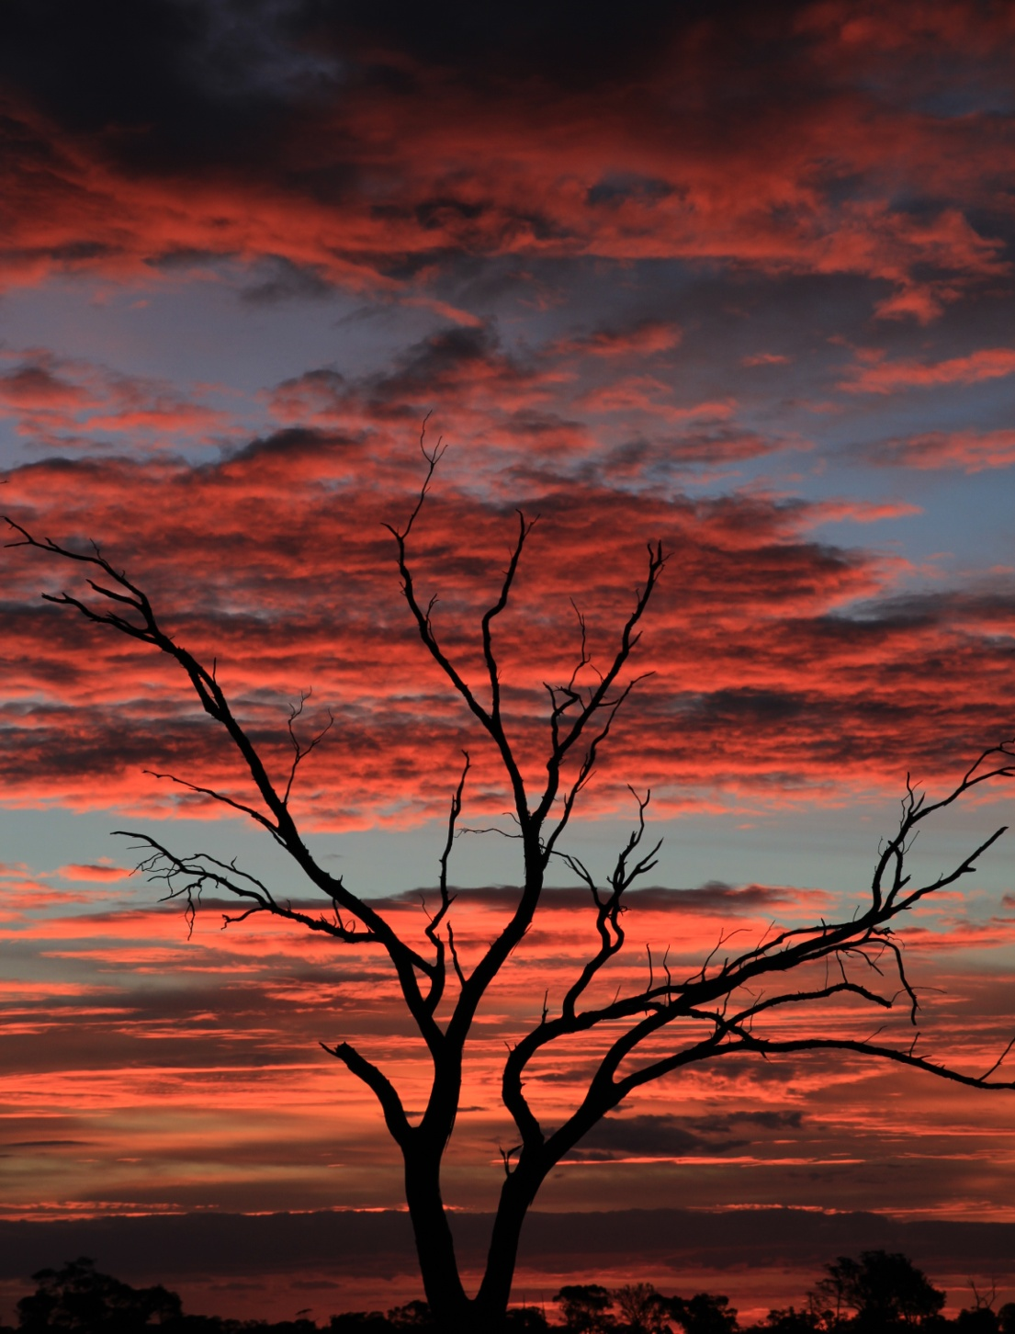
For more information:
Rob Tyson
Managing Director
rtyson@peelmining.com.au
Unit 1, 34 Kings Park Road,
West Perth, WA 6005
Tel: 08 9382 3955
Peel Mining Limited (ASX:PEX)
www.peelmining.com.au

